Slide 1
Version 1.00
UCSD CSE 30
Computer Organization and Systems Programming
Aarch32 Assembly – Part 1
Week 6
Lecture 16 – November 1, 2022
Keith Muller

Slide 2
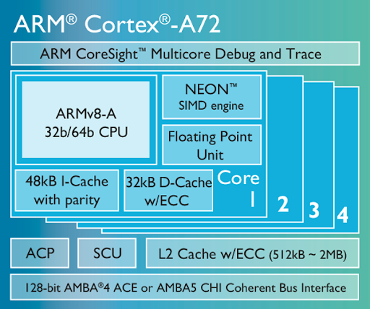
Arm Core Organization & Floorplan Examples
Single core arm die (not an A72) Floorplan
x

Slide 3

Memory Triangle: Hardware Cost/Performance/Capacity Tiers
Assume 1 clock cycle per machine instruction
Goal: keep most Data Accesses high in the Triangle
Smallest Capacity
Highest Performance
Highest cost/capacity
Largest Capacity
Slowest performance
Lowest Cost $/capacity
Registers
ALU & Logic
Address
Data
Caches
CPU
Address
Data
DIMM memory Module
~300 K Cycles
PCI-E
Clock cycle =~ time to access; larger is slower
Design Tradeoff: Based on workload considering cost and performance targets
Source: Dive Into Systems Text
x

Slide 4
32-Bit Arm - Registers
External memory
CPU
arithmetic Logic Unit
1- Byte
Registers are memory located within the CPU
Registers are the fastest read and write storage
Register is word size in length stores 32-bit values
Memory is accessed using pointers in registers
In assembly language the registers have predefined names starting with an r to differentiate them from memory addresses which are labels (address)
16 registers: from r0 to r15 (encoded: 0x0 – 0xf)
0xFFFFFFFF
Registers
4-bytes
r15
r14
r13
r12
r11
r10
r9
r8
r7
r6
r5
r4
r3
r2
r1
r0
4-bit address
32-bit address
0x00000000
CPU Memory Bus = Address + Data
Capacity:4 GBytes
Capacity: 16 Words
x

Slide 5
Assembly and Machine Code
0xFF…FF
OS kernel [protected]
Machine Language (or code): Set of instructions the CPU executes are encoded in memory using patterns of ones and zeros (like binary numbers)
Assembly language is a symbolic version of the machine language
Each assembly statement (called an Instruction)
Executes exactly one from a list of simple commands
Instructions describe operations (e.g., =, +, -, *)
Execution flows from low to high memory one instruction at a time unless there is a branch
One line of arm32 machine code contains one instruction in one word (32 bits)
Assembler (gnu as) translates assembly to machine code
Stack
Shared Libraries
32-bit address space
Heap
Memory word (4-bytes)
Address contents Assembly Language
Static Data (+BSS)
Read Only Data
1040c: e28db004 add fp, sp, 4
10410: e59f0010 ldr r0, [pc, 16]
10414: ebffffb3 bl 102e8 <printf>
10418: e3a00000 mov r0, 0
1041c: e24bd004 sub sp, fp, 4
Read Only Text Segment
Machine Code
0x00…00
high <- low bytes
x

Slide 6
Anatomy of an Assembly instruction
Assembly language instructions specify an operation and the operands to the instruction (arguments of the operation)
Three basic types of operands
Destination: where the result will be stored
Source: where data is read from
Immediate: an actual value like the 1 in y = x + 1
operation
Operands (variables)
add r0, r1, r2
add r0, r1, 1
Source Operands
Destination Operand
Immediate Operand
x

Slide 7
Meaning of an Instruction
Operations are abbreviated int opcodes (1– 5 letters)
Assembly Instructions are specified with a very regular syntax
Opcodes are followed by arguments
Usually the destination argument is next, then one or more source arguments (this is not strictly the case, but it is generally true)
Why this order?
Analogy to C or Java
int r0, r1, r2;
r0 = r1 + r2; // c
r0 = r1 + r2
add r0, r1, r2 // assembly
x

Slide 8
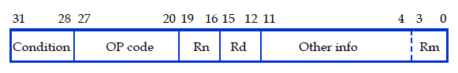
32-Bit Arm - Registers
registers
Arithmetic & Logic Unit (ALU)
All computations (add, subtract, etc.) are performed in the ALU
4-bytes
r15
r14
r13
r12
r11
r10
r9
r8
r7
r6
r5
r4
r3
r2
r1
r0
Almost all arithmetic, logic operations and data movement operations involve at least one register
As a result, Register addresses are directly encoded into 4-bit fields in machine instructions (see below)
4-bit address
Capacity: 16 Words
x

Slide 9
Program Execution: A Series of Instructions
Instructions are retrieved sequentially from memory
Each instruction executes to completion before the next instruction is completed
Conceptually the pc (program counter) points at executing instruction
exceptions: loops, function calls, traps,..
Main Memory
OS kernel [protected]
Stack
Shared Libraries
Register contents inside the CPU
r0 = 1 r1 = 2
initial values
Heap
Memory Content in Text segment
Static Data (+BSS)
add r0, r1, r1
Low memory
r0 = 4 r1 = 2
Read Only Data
add r0, r0, r0
r0 = 8 r1 = 2
Read Only Text Segment
add r0, r0, r0
r0 = 16 r1 = 2
sub r1, r0, r1
r0 = 16 r1 = 14
Low memory
x

Slide 10
Program Execution: Looping in the Execution Flow
Repeat the series of instructions in a loop means altering the flow of execution
This is used with if statements and loops
Below is an infinite loop (br instruction: unconditional branch: "goto"
the address of this instruction has the name .Lloop
r0 = 1 r1 = 2
.Lloop: add r0, r1, r1
r0 = 4 r1 = 2
add r0, r0, r0
r0 = 8 r1 = 2
add r0, r0, r0
r0 = 16 r1 = 2
sub r1, r0, r1
r0 = 16 r1 = 14
br .Lloop
branch to the instruction at memory location with the label: .Lloop
x

Slide 11
How to Access Memory?
0xFF…FF
OS kernel [protected]
Consider r0 = r1 + r2
Operation code: add Destination: r0
Operand 1: r1 Operand 2: r2
Aarch32 Instructions are always word size: 32 bits wide
Some bits must be used to specify the operation code
Some bits must be used to specify the destination
Some bits must be used to specify the operands
Address space is 32 bits wide – POINTERS in registers
Stack
Shared Libraries
32-bit Address space
Heap
32 bits wide
Static Data (+BSS)
31 |  |  | 0
Opcode
Destination
Operand 1
Operand 2
Read Only Data
add r0 r1,r2
Read Only Text Segment
31 | 0
Address of a location in memory
0x00…00
NOT ENOUGH BITS for FULL Addresses in the instruction
x

Slide 12
32-Bit Arm is a Load/Store Architecture
memory
registers
1- Byte
Load:
(also called a Fill)
Copy the contents of a variable from memory into a register.
0xFFFFFFFF
All computations (add, subtract, etc.) are performed in the ALU
4-bytes
r15
r14
r13
r12
r11
r10
r9
r8
r7
r6
r5
r4
r3
r2
r1
r0
Arithmetic & Logic Unit (ALU)
4-bit address
Store:
(also called a Spill)
Copy the contents of a register back into a variable in memory.
32-bit address
Instruction operands and results are only in registers
Capacity: 16 Words
0x00000000
Capacity:4 GBytes
x

Slide 13
Using Registers as Pointers to Memory - Load
External memory
We want to do a x[1] = x[0]
We have to do this in two steps
int r3;
int x[2];
int *r1 = &x; // r1 contains address
…
r3 = *(r1); // memory to register
*(r1 + 1) = r3; // register to memory
r15
r14
r13
r12
r11
r10
r9
r8
r7
r6
r5
r4
r3
r2
r1
r0
0x00001010
0x0000100c
Load register from memory
ldr r3, [r1, 0]
address = r1 + 0 = 0x1004
x[1]
0x00001008
reads memory
0x4
0x4321
0x3
0x2
0x1004
x[0]
0x1
0x00001004
The [ ] around the operands is like the * dereference op
points at
0x00001000
we will cover this instruction in more detail later
x

Slide 14
Using Registers as Pointers to Memory - Store
External memory
We want to do a x[1] = x[0]
We have to do this in two steps
int r3;
int x[2];
int *r1 = &x; // r1 contains address
…
r3 = *(r1); // memory to register
*(r1 + 1) = r3; // register to memory
r15
r14
r13
r12
r11
r10
r9
r8
r7
r6
r5
r4
r3
r2
r1
r0
0x00001010
0x0000100c
0x4
writes memory
0x3
0x2
Store register to memory
str r3, [r1, 4]
address = r1 + 4 = 0x1008
x[1]
0x1
0x00001008
0x4
0x4321
0x3
r1 + 4
points at
0x2
0x1004
x[0]
0x1
0x00001004
The [ ] around the operands is like the * dereference op
0x00001000
We will cover this instruction in more detail later
x

Slide 15
Arm Register Summary
16 Named registers r0 – r15
The operands of almost all instructions are registers
To operate on a variable in memory do the following:
Load the value(s) from memory into a register
Execute the instruction
Store the result back into memory (only if needed!)
Going to/from memory is expensive
4X to 20X+ slower than accessing a register
Strategy: Keep variables in registers as much as possible
x

Slide 16
Using Aarch32 Registers
Special Use Registers
program counter
r15/pc
There are two basic groups of registers, general purpose and special use
General purpose registers can be used to contain up to 32-bits of data, but you must follow the rules for their use
Rules specify how registers are to be used so software can communicate and share the use of registers (later slides)
Special purpose registers: dedicated hardware use (like r15 the pc) or special use when used with certain instructions (like r13 & r14)
r15/pc is the program counter that contains the address of an instruction being executed (not exactly … later)
Special Use Registers
function call implementation & long branching
r14/lr
r13/sp
r12/ip
r11/fp
r10
r9
Preserved registers
Called functions can't change
r8
r7
r6
r5
r4
Scratch Registers
First 4 Function Parameters
Function return value
Called functions can change
r3
r2
r1
r0
x

Slide 17
CPU Operational Overview: Executing Machine Code
Everything has a memory address: instructions & data
Machine code uses addresses for loops, branches, function calls, variables, etc.
1 Fetch
read the instruction into memory (fetch)
program counter is automatically incremented (+4) to contain the address of the next instruction in memory Instructions are 32 bits
2 Decode
Decodes the instruction and sets up execution
3 Execute
CPU completes the execution of the instruction
Execution may alter the pc to take branches, etc.
Go to fetch
text segment in memory
0001042c <inloop>:
1042c: e3530061 cmp r3, 0x61
10430: ba000002 blt 10440 <store>
10434: e353007a cmp r3, 0x7a
10438: ca000000 bgt 10440 <store>
1043c: e2433020 sub r3, r3, #32
00010440 <store>:
10440: e7c13002 strb r3, [r1, r2]
10444: e2822001 add r2, r2, 0x1
10448: e7d03002 ldrb r3, [r0, r2]
1044c: e3530000 cmp r3, 0x0
10450: 1afffff5 bne 1042c <inloop>
address contents
assembly version
r15/pc
r15/pc
r15/pc
r15/pc
r15/pc
r15/pc
x

Slide 18
AArch32 Instruction Categories
Data movement to/from memory
Data Transfer Instructions between memory and registers
Load, Store
Arithmetic and logic
Data processing Instructions (registers only)
Add, Subtract, Multiply, Shift, Rotate, …
Control Flow
Compare, Test, If-then, Branch, function calls
Miscellaneous
Traps (OS system calls), Breakpoints, wait for events, interrupt enable/disable, data memory barrier, data synchronization barrier
Many others that we will not cover in the class
Arithmetic and logic
Data Movement
Control Flow
Miscellaneous
x

Slide 19
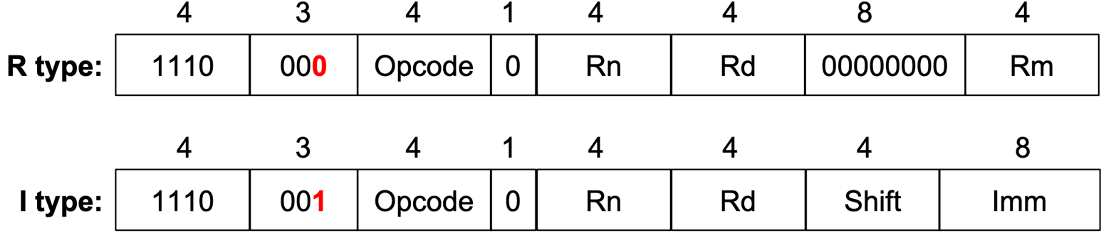
Basic Arm Machine Code Instructions
Instructions consist of several fields that encode the opcode and arguments to the opcode
Special fields enable extended functionality - later
Several 4-bit operand fields for specifying the source and destination of the operation, usually one of the 16 registers
Embedded constants ("immediate values") of various size and "configuration"
Basic Data processing instruction formats (below)
R type instruction: add r0, r1, r2 // third operand is a register
I type instruction: add r0, r0, 1 // third operand is an immediate value
Rotate
x

Slide 20
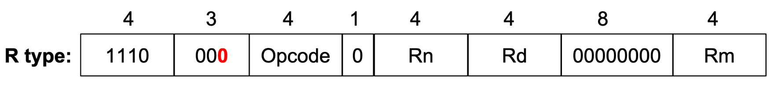
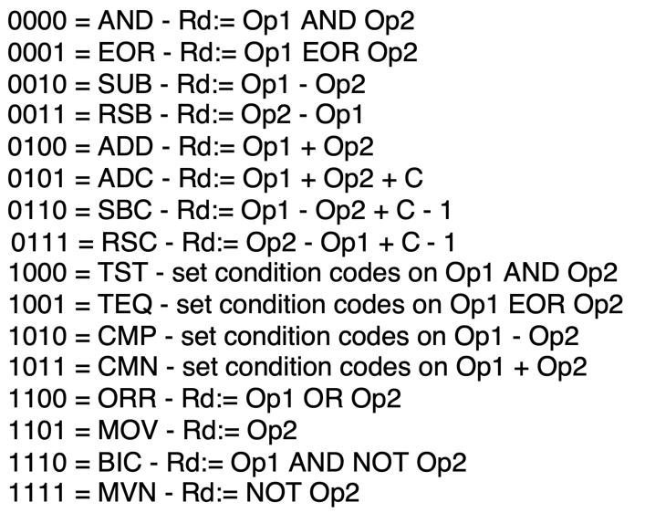
R (register) Type Data Processing: Machine Code
Instructions that process data using three-register arguments
The general instruction format is (not all fields will be in every instruction)
opcode Rd (destination), Rn (operand 1), Rm (operand 2)
add r0, r1, r3
is encoded as
1110 0000 1000 0001 0000 0000 0000 0011
in hex is
0xe0810003
x

Slide 21

I (immediate) Type Data Processing: Machine Code
Instructions that process data using two registers and a constant (in the instruction)
The general instruction format is (not all fields will be in every instruction)
opcode Rd (destination), Rn (operand 1), constant
I
immediate value
12 bits only!!!!
add r0, r1, 49
is encoded as
1110 0000 1000 0001 0000 0000 0011 0001
in hex is
0xe0810031
x

Slide 22
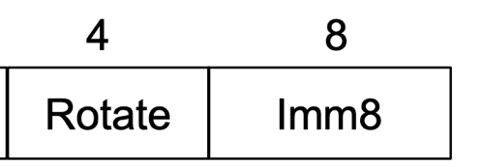
How are I – Type Constants Encoded in the instruction?
Aarch32 provides only 8-bits for specifying an immediate constant value
Without "rotation" immediate values are limited to the range of positive 0-255
Imm8 expands to 32 bits and does a rotate right to achieve additional constant values (YUCK)
positions to
rotate X 2
unsigned value to rotate
rot4 value | 32-bit constant result
0000 | 0000 0000 0000 0000 0000 0000 1111 1111
0001 (2 bits) | 1100 0000 0000 0000 0000 0000 0011 1111
results are interpreted as a 2's complement number
two bits rotated right
x

Slide 23
First Look: Copying Values To Registers - MOV
mov r0, r1
// Copies all 32 bits
// of the value held
// in register r1 into
// the register r0
register r1
register r0
mov r0, 100
// Expands an imm8 value 100
// stored in the instruction
// into the register r0
100
register r0
x

Slide 24
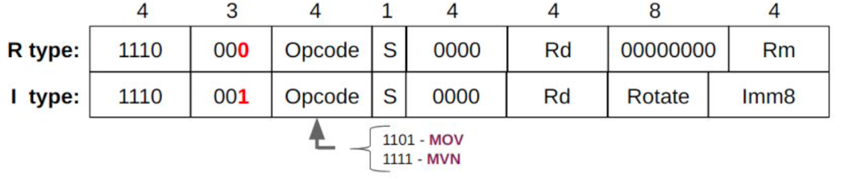
mov – Copies Register Content between registers
machine code bit fields
mov
Rd
rot4
imm8
mov
Rd
Rm
destination register
constant (immediate value)
destination register
source register
mov Rd, constant // Rd = constant
mov Rd, Rm // Rd = Rm
mov r1, r5 // r1 = r5
mov r1, 1 // r1 = 1
mov r1, -4 // r1 = -4
x

Slide 25
What is a Bitwise Operation?
a = | a₇ | a₆ | a₅ | a₄ | a₃ | a₂ | a₁ | a₀
 | <op> | <op> | <op> | <op> | <op> | <op> | <op> | <op>
b = | b₇ | b₆ | b₅ | b₄ | b₃ | b₂ | b₁ | b₀
result = | c₇ | c₆ | c₅ | c₄ | c₃ | c₂ | c₁ | c₀
Bitwise operators are applied to each of the corresponding bit positions in each variable
Each bit position of the result depends only on bits in the same bit position within the operands
x

Slide 26
Bitwise Not (vs Boolean Not)
Bitwise NOT
a | ~a
0 | 1
1 | 0
~ 1100
----
0011
in C
int output = ~a;
 | Bitwise Not
number | 0101 1010 0101 1010 1111 0000 1001 0110
~number | 1010 0101 1010 0101 0000 1111 0110 1001
Meaning | Operator | Operator | Meaning
Boolean NOT | !b | ~b | Bitwise NOT
Boolean operators act on the entire value not the individual bits
Type | Operation | result
bitwise | ~0x01 | 1111 1111 1111 1111 1111 1111 1111 1110
Boolean | !0x01 | 0000 0000 0000 0000 0000 0000 0000 0000
x

Slide 27
First Look: Copying Values To Registers – MVN (negate)
mvn r0, r1
// Copies all 32 bits
// of the value held
// in register r1 into
// the register r0
// then does a bitwise NOT
register r1
Bitwise NOT
~ 1100
----
0011
register r0
A bitwise NOT operation
0x 0c
mvn r0, 12
// Expands an imm8 value 0x0c
// stored in the instruction
// into a register then does
// a bitwise NOT
0x0c
imm8 expansion
0x0000000c
bitwise not
register r0
0xffff fff3
0xfffffff3
x

Slide 28
mvn – Copies NOT (~) of Register content between registers
mvn
Rd
rot4
imm8
mvn
Rd
Rm
destination register
constant (immediate value)
destination register
source register
~ 1100
----
0011
mvn Rd, constant // Rd = constant
mvn Rd, Rm // Rd = Rm
Bitwise NOT
bitwise NOT operation. Immediate (constant) version copies to 32-bit register, then does a bitwise NOT
mvn r1, 4 // x = ~4
mvn r1, r5 // x = ~y in C
mvn r1, 0 // x = -1
imm8 | extended imm8 | inverted imm8 | signed base 10
0x00 | 0x00 00 00 00 | 0xff ff ff ff | -1
0xff | 0x00 00 00 ff | 0xff ff ff 00 | -256
invert the bits
copy into 32 bits zero extend
r1
0xfffffffb
0x00000004
0x4
r1
0x55555555
0xaaaaaaaa
r5
r1
0x11111111
0x0
x

Slide 29
First Look: Add/Sub Registers
add r0, r1, r2
// Adds r1 to r2 and
// stores the result // in r0
register r1
+
register r2
register r0
register r1
-
100
sub r0, r1, 100
// Perform r1 – 100 and
// stores the result in
// r0
register r0
x

Slide 30
add/sub/rsub – Add or Subtract two integers
add/sub/rsub
Rd
Rn
rot4
imm8
add/sub/rsub
Rd
Rn
Rm
destination
operand 1
Operand 2 constant
destination
operand 1
Operand 2
add Rd, Rn, constant // Rd = Rn + constant
sub Rd, Rn, constant // Rd = Rn - constant
rsub Rd, Rn, constant // Rd = constant - Rn
add Rd, Rn, Rm // Rd = Rn + Rm
sub Rd, Rn, Rm // Rd = Rn - Rm
rsub Rd, Rn, Rm // Rd = Rm - Rn
add r1, r2, r3 // r1 = r2 + r3
sub r1, r1, 1 // r1 = r1 – 1; or r1--
add r1, r2, 234 // r1 = r2 + 234
mov r5, 5 // r5 = 5
mov r7, 7 // r7 = 7
add r7, r7, r5 // r7 = 12 r5 = 5
x

Slide 31
Writing a Sequence of Add & Subtract Instructions
You need to perform the following sequence of integer adds/subtracts
a = b + c + d - e;
Since ARM uses a three-operand instruction set, you can only operate on two operands at a time
So, you need to use one register as an accumulator and create a sequence of add instructions to build up the solution
a = b + c + d - e;
r0 = r1 + r2 + r3 – r4;
r0 = ((r1 + r2) + r3) – r4;
r0 = r1 + r2;
r0 = r0 + r3
r0 = r0 – r4
add r0, r1, r2
add r0, r0, r3
sub r0, r0, r4
r0 ← a
r1 ← b
r2 ← c
r3 ← d
r4 ← e
a = (b + c) – 5;
r0 = (r1 + r2) – 5;
add r0, r1, r2
sub r0, r0, 5
x

Slide 32
Overview: Line Layout in an Arm Assembly Source File - 1
column 1 column 2 column 3 column 4
label: operation operand(s) // comments
tab
white space
white space
Assembly language source text files are line oriented (each ending in a '\n')
Each line represents a starting address in memory and does one of:
Specifies the contents of memory for a variable (segments containing data)
Specifies the contents of memory for an instruction (text segment)
Assembler directives tell the assembler to do something (for example, change label scope, define a macro, etc.) that does not allocate memory
Each line is organized into up to four columns
Not every column is used on each line
Not every line will result in memory being allocated
x

Slide 33
Overview: Line Layout in an Arm Assembly Source File - 2
label: operation operand(s) // comment
// assembler directive below
cnt: .word 5 /* define a global int cnt = 5;
/* instruction below */
add r1 r2, r3 // add the values
Labels (optional); starts in column 1
Only used when you need to associate a name to a starting location in memory; You can then refer to the address by name in an instruction
Operation type 1: assembler directives (all start with a period e.g. .word )
Operation Type 2: assembly language instructions
Zero or more operands as required by the instruction or assembler directive
Comments C and C++ style; also @ in the place of a C++ comment //
x

Slide 34
Labels in Arm Assembly
local label
.Lmesg: .string "Hello CSE30! We Are CountinG UpPpER cASe letters!"
...
main:
push {fp, lr}
...
.Lwhile:
add r2, r2, 1 // increment char pointer
label .Lmesg is the starting address for the ascii string
Regular label
label main is the starting address of the push instruction
local label
label .Lwhile is the starting address of the add instruction
Remember, a Label associates a name with memory location
Regular Label:
Used with a Function name (label) or for static variables in any of the data segments
Local Label: Name starts with .L (local label prefix) only usable in the same file
Targets for branches (if), switch, goto, break, continue, loops (for, while, do-while)
Anonymous variables (string not foo in char *foo = "anonymous variable")
Read only literals when allocated in the text segment – special case)
x

Slide 35
Assembler Directives: Label Scope Control (Normal Labels only)
.extern printf
.extern fgets
.extern strcpy
.global fbuf
.extern <label>
Imports label (function name, symbol or a static variable name);
An address associated with the label from another file can be used by code in this file
.global <label>
Exports label (or symbol) to be visible outside the source file boundary (other assembly or c source)
label is either a function name or a global variable name
Without .global, by default labels are local to the file from the point where they are defined
x

Slide 36
Assembler Directives: .equ and .equiv
.equ BLKSZ, 10240 // buffer size in bytes
.equ BUFCNT, 100*4 // buffer for 100 ints
.equiv STRSZ, 128 // buffer for 128 bytes
.equiv STRSZ, 1280 // ERROR! already defined!
.equ BLKSZ, STRSZ * 4 // redefine BLKSZ from here
.equ <symbol>, <expression>
Defines and sets the value of a symbol to the evaluation of the expression
Used for specifying constants, like a #define in C
You can (re)set a symbol many times in the file, last one seen applies
.equ BLKSZ, 10240 // buffer size in bytes
// other lines
.equ BLKSZ, 1024 // buffer size in bytes
.equiv <symbol>, <expression>
.equiv directive is like .equ except that the assembler will signal an error if symbol is already defined
x

Slide 37
Example: Assembler Directive and Instructions
assembler directive .equ does not allocate any memory (NULL = 0)
space.S
Regular label main
is associated with memory location 0x3000
10 .equ NULL, 0
11 main:
12 3000 0310A0E1 mov r1, r3
13 .Lloop:
14 3004 043083E2 add r3, r3, 4
15 3008 001093E5 ldr r1, [r3]
16 300c 000051E3 cmp r1, NULL
17 3010 FBFFFF1A bne .Lloop
Local label .Lloop
is associated with memory location 0x3004
Memory Contents
Warning contents shown in "reverse" byte order: Lsb – Msb
output generated with
gcc -c -Wa,-ahlns space.S
partial output is shown
Instruction Memory Addresses (lowest 2-bits are always are 00)
Notice alignment and how addresses increase by 4 (32-bit instructions)
x

Slide 38
Unconditional Branching – Forces Execution to Continue at a Specified Label (goto)
Unconditional Branch instruction (branch to only local labels in CSE30)
b .Llabel
Causes an unconditional branch (aka goto) to the instruction with the address .Llabel
.Llabel is called a branch target label (the "target" of a branch instruction)
Be careful! do not to branch to a function label!
.Llabel: pc is the base register with the offset being imm24 shifted left two bits (+/- 32 MB)
imm24 is the number of instructions from pc+8
b
imm24
b .Ldone
:
.Ldone: add r0, EXIT_SUCCESS // set return value
x

Slide 39
Examples of of Unconditional Branching
Unconditional Branch Forward
Infinite loop
b .Lforward
add r1, r2, 4
add r0, r6, 2
add r3, r7, 4
.Lforward:
sub r1, r2, 4
.Lbackward:
add r1, r2, 4
sub r1, r2, 4
add r4, r6, r7
b .Lbackward
// not reachable
Branches are used to change execution flow using labels as the branch target
In these example, .Lforward and .Lbackward are the branch target labels
Branch target labels are placed at the beginning of the line (or above it)
x

Slide 40
cmp/cmm – Making Conditional Tests
cmp/cmm
Rn
rot4
imm8
cmp/cmm
Rn
Rm
operand 1
Operand 2 constant
operand 1
Operand 2
Bytes: 0 <= imm8 <= 255 + values from "rotating" rot 4 bits
cmp Rn, constant // Rn – constant; then sets condition flags
cmm Rn, constant // Rn + constant; then sets condition flags
cmp Rn, Rm // Rn – Rm; then sets condition flags
cmm Rn, Rm // Rn + Rm; then sets condition flags
The values stored in the registers Rn and Rm are not changed
The assembler will automatically substitute cmn for negative immediate values
cmp r1, 0 // r1 – 0 and sets flags on the result
cmp r1, r2 // r1 – r2 and sets flags on the result
x

Slide 41
Quick Overview of the Condition Bits/Flags
CPSR
N
Z
C
V
Execution Mode
31
30
29
28
5 0
The CSPR is a special register (like the other registers) in the CPU
The four bits at the left are called the Condition Code flags
Summarize the result of a previous instruction
Not all instruction will change the CC bits
Specifically, Condition Code flags are set by cmm/cmp (and others)
Example: cmp r4, r3
N (Negative) flag: Set to 1 when the result of r4 – r3 is negative, set to 0 otherwise
Z (Zero) flag: Set to 1 when the results of r4 – r3 is 0, set to 0 otherwise
C (Carry bit) flag: Set to 1 when r4 – r3 does not have a borrow, set to 0 otherwise
V flag (oVerflow): Set to 1 when r4 – r3 causes an overflow, set to 0 otherwise
x

Slide 42
Conditional Branch: Changing the Next Instruction to Execute
Branch instruction
bsuffix .Llabel
Bits in the condition field specify the conditions when the branch happens
If the condition evaluates to be true, the next instruction executed is located at .Llabel:
If the condition evaluates to be false, the next instruction executed is located immediately after the branch
Unconditional branch is when the condition is "always"
Condition | Meaning | Flag Checked
BEQ | Equal | Z = 1
BNE | Not equal | Z = 0
BGE | Signed ≥ ("Greater than or Equal") | N = V
BLT | Signed < ("Less Than") | N ≠ V
BGT | Signed > ("Greater Than") | Z = 0 && N = V
BLE | Signed ≤ ("Less than or Equal") | Z = 1 || N ≠ V
BHS | Unsigned ≥ ("Higher or Same") or Carry Set | C = 1
BLO | Unsigned < ("Lower") or Carry Clear | C = 0
BHI | Unsigned > ("Higher") | C = 1 && Z = 0
BLS | Unsigned ≤ ("Lower or Same") | C = 0 || Z = 1
BMI | Minus/negative | N = 1
BPL | Plus - positive or zero (non-negative) | N = 0
BVS | Overflow | V = 1
BVC | No overflow | V = 0
B (BAL) | Always (unconditional)
cond
b
imm24
x

Slide 43
Anatomy of a Sample Branch: Changing the Next Instruction to Execute
Branch condition
Test (branch guard)
if (r3 != r4) {
r1 = r2 + 1;
}
r3 = r1;
condition true block
Branch guard: determines whether to execute the "true" block
When the branch guard evaluates to false, branch around the true block
x

Slide 44
Conditional Branch: Changing the Next Instruction to Execute
cmp r3, r4
beq .Ldone
// otherwise do the add
add r1, r2, 1
b .Ldone
.Ldone:
mov r3, r1
if (r3 != r4)
r1 = r2 + 1;
r3 = r1;
Condition | Meaning | Flag Checked
BEQ | Equal | Z = 1
B | Always (unconditional)
cmp r3, r4 // r3 – r4
// if r3 != r4 sets Z = 0
Use a cmp/cmm instruction to set the condition bits
Follow the cmp/cmm with one or more variants of the conditional branch instruction Conditional branch instructions if evaluate to true (bases on the CC bits set) will go to the instruction with the branch label. Otherwise, it executes the instruction that follows
You can have one or more conditional branches after a single cmp/cmm
x

Slide 45
When do you use a Signed or Unsigned Conditional Branch?
example with 4 bits (arm is 32)
0111₂ > 1100₂ ?
Compare
7 > 12 ?
signed
2's complement
unsigned
Compare
+7 > -4 ?
(FALSE)
(TRUE)
Condition | Suffix For Unsigned Operands: | Suffix For Signed Operands:
> | BHI (Higher Than) | BGT (Greater Than)
>= | BHS (Higher Than or Same) (BCS) | BGE (Greater Than or Equal)
< | BLO (Lower Than) (BCC ) | BLT (Less Than)
<= | BLS (Lower Than or Same) | BLE (Less Than or Equal)
== | BEQ (Equal)
!= | BNE (Not Equal)
x

Slide 46
Review Anatomy of a Conditional Branch: If statement
Branch condition
Test (branch guard)
if (r0 == 5) {
/* condition block #1 */
} else {
/* condition block #2 */
}
condition true block
condition false block
In C, when the branch guard (condition test) evaluates non-zero you fall through to the condition true block, otherwise you branch to the condition false block
Block order: (the order the blocks appear in C code) can be changed by inverting the conditional test, swapping the order of the true and false blocks
Branch condition
Test (branch guard)
if (r0 != 5) {
/* condition block #2 */
} else {
/* condition block #1 */
}
condition true block
condition false block
x

Slide 47
Examples: Guards (Conditional Tests) and their Inverse
Compare in C | "Inverse" Compare in C
== | !=
!= | ==
> | <=
>= | <
< | >=
<= | >
Changing the conditional test (guard) to its inverse, allows you to swap the order of the blocks in an if else statement
x

Slide 48
Program Flow: Keeping the same "Block Order" as C
Branch guard
int r0;
if (r0 == 5) {
/* when true "fall through" to here */
/* condition true block */
}
/* in assembly branch to here if not true */
condition true block
In ARM32, you either fall through (execute the next instruction in sequence) or branch to a specific instruction and then resume sequential instruction execution
In order to keep the same block order as the C version that says: fall through to the condition true block when the branch guard evaluates to be true
Assembly: invert the condition test to branch around the condition true block
Summary: In ARM32 use a condition test that specifies the opposite of the condition used in C , then branch around the condition true block
x

Slide 49
Branch Guard "Adjustment" Table Preserving Block Order In Code
Compare in C | "Inverse" Compare in C | "Inverse" Signed Assembly | "Inverse" Unsigned Assembly
== | != | bne | bne
!= | == | beq | beq
> | <= | ble | bls
>= | < | blt | blo
< | >= | bge | bhs
<= | > | bgt | bhi
if (r0 compare 5)
/* condition true block */
}
cmp r0, 5
inverse .Lelse
// condition true block
.Lendif:
x

Slide 50
Program Flow: Simple If statement, No Else
Approach: adjust the conditional test then branch around the true block
Use a conditional test that specifies the inverse of the condition used in C
C source Code | Incorrect Assembly | Correct Assembly
int r0; if (r0 > 10) | cmp r0, 10 bgt .Lendif .Lendif: | cmp r0, 10 ble .Lendif .Lendif:
If r0 == 5 true
then fall through to the true block
If r0 == 5 false
then branch around the true block
int r0;
if (r0 == 5) {
/* condition true block */
/* fall through */
}
/* branch around to this code */
cmp r0, 5
bne .Lendif
/* condition true block */
/* fall through */
.Lendif:
/* branch around to this code */
x

Slide 51
If statement examples – Branch Around the True block!
cmp r0, 5
bne .Lendif
add r1, r2, r3
add r2, r2, 1
.Lendif:
mov r3, r2
If r0 == 5 false
then branch around the true block
int r0;
if (r0 == 5) {
r1 = r2++ + r3;
}
r2 = r3;
cmp r0, 5
bgt .Lendif
mov r1, r2
add r2, r2, 1
.Lendif:
mov r3, r2
int r0;
if (r0 <= 5) {
r1 = r2++;
}
r2 = r3;
unsigned int r0, r1;
if (r0 > r1) {
r1 = r0;
}
r2 = r3;
cmp r0, r1
bls .Lendif
mov r1, r0
.Lendif:
mov r3, r2
x

Slide 52
Program Flow: If with an Else
If r0 == 5 false
then branch to false block
cmp r0, 5
bne .Lelse
/* cond. true block */
/*
* Now branch around the
* condition false block
*/
b .Lendif
.Lelse
/* condition false block */
/* fall through */
.Lendif:
mov r1, 4
if (r0 == 5) {
/* cond. true block */
} else {
/* condition false block */
/* fall through */
}
r1 = 4;
If r0 == 5 false
then branch to false block
Make the adjustment to the conditional test to branch to the false block
When you finish the true block, you do an unconditional branch around the false block
The false block falls through to the following instructions
x

Slide 53
If with an Else Examples
Branch condition
Test (branch guard)
If r0 < r1 false
then branch to false block
cmp r0, r1
bge .Lelse
mov r2, 1
b .Lendif
.Lelse:
mov r2, 0
/* fall through */
.Lendif:
add r4, r2, r4
…
if (r0 < r1) {
r2 = 1;
// branch around else
} else {
r2 = 0;
/* fall through */
}
r4 = r2 + r4;
condition true block
condition false block
x

Slide 54
If with an Else Block order: All These Are Equivalent
if (r0 < r1) {
r2 = 1;
// branch around else
} else {
r2 = 0;
/* fall through */
}
r4 = r2 + r4;
cmp r0, r1
bge .Lelse
mov r2, 1
b .Lendif
.Lelse:
mov r2, 0
/* fall through */
.Lendif:
add r4, r2, r4
if (r0 >= r1) {
r2 = 0;
// branch around else
} else {
r2 = 1;
/* fall through */
}
r4 = r2 + r4;
cmp r0, r1
blt .Lelse
mov r2, 0
b .Lendif
.Lelse:
mov r2, 1
/* fall through */
.Lendif:
add r4, r2, r4
x

Slide 55
Branching What not to do: Spaghetti Code
Use fall-through!
do not branch to the next statement!
.Lelse:
mov r2, 0
b .Lendif // not needed, slows code
.Lendif:
add r1, r2, r3
.Lelse:
mov r2, 0
add r1, r2, r3
mov r1, 1
mov r2, 2
b .Lthree
mov r5, 5
b .Lsix
.Lthree:
mov r3, 3
mov r4, 4
b .Lseven
.Lsix:
mov r6, 6
.Lseven:
mov r7, 7
Observation
Using many br commands is a sign you should look to reorganize your code
Much faster and easier to read!
mov r1, 1
mov r2, 2
mov r3, 3
mov r4, 4
b .Lseven
mov r5, 5
mov r6, 6
.Lseven:
mov r7, 7
Notice after "unwinding" this unreachable code is easier to detect
x

Slide 56
Bad Style: Branching Upwards (Not a loop)
cmp r3, r4
beq .Lelse1
bgt .Lelse2
cmp r0, r1
bge .Lelse2
mov r2, 1
b .Lendif
.Lelse1:
mov r2, 0
b .Lendif
.Lelse2:
add r4, r3, r2
b .Lesle1
.Lendif:
add r4, r2, r4
Do not Branch "Upwards" unless it is part of a loop (later slides)
If you cannot easily write the equivalent C code for your assembly code, you may have code that is harder to read than it should be
Action: adjust your assembly code to have a similar structure as an equivalent version written in C
x

Slide 57
Branching: Use Fall through!
Do not do the following:
cmp r0, 0
beq .Lthen
b .Lendif
.Lthen:
add r1, r1, 1
.Lendif:
add r1, r1, 2
Avoid goto like structure
Do not use unnecessary branches (sometimes called a “goto” like structure) when a “fall through” works
You can see this by structures that have a conditional branch around an unconditional branch that immediately follows it
Not good!
Two adjacent branches
Do the following:
cmp r0, 0
bne .Lendif // fall through
add r1, r1, 1
.Lendif:
add r1, r1, 2
x

Slide 58
Switch Statement
Approach 1 – Branch Block
Approach 2 – if else equiv.
cmp r0, 1
beq .Lblk1
cmp r0, 2
beq .Lblk2
// fall through
// default 3
b .Lendsw // break
.Lblk1
// block 1
b .Lendsw // break
.Lblk2:
// block 2
// fall through
// NO b .Lendsw
.Lendsw:
cmp r0, 1
bne .Lblk2
// block 1
b .Lendsw // break
.Lblk2:
cmp r0, 2
bne .Ldefault
// block 2
b .Lendsw // break
.Ldefault:
// default 3
// fall through
// NO b .Lendsw
.Lendsw:
switch (r0) {
case 1:
// block 1
break;
case 2:
// block 2
break;
default:
// default 3
break;
}
Branch block
x

Slide 59
Program Flow – Short Circuit or Minimal Evaluation
In evaluation of conditional guard expressions, C uses what is called short circuit or minimal evaluation
Each expression argument is evaluated in sequence from left to right including any side effects (modified using parenthesis), before (optionally) evaluating the next expression argument
If after evaluating an argument, the value of the entire expression can be determined, then the remaining arguments are NOT evaluated (for performance)
if ((x == 5) || (y > 3)) // if x == 5 then y > 3 is not evaluated
if (x || ++x) // true block always executed: ++x!
printf("%d\n", x);
if ((a != 0) && func(b)) // if a is 0, func(b) is not called
// do_something();
x

Slide 60
Program Flow – If statements && compound tests - 1
cmp r0, 5
bne .Lendif
cmp r1, 3
ble .Lendif
mov r2, r5. // true block
// fall through
.Lendif:
mov r4, r3
If r0 == 5 false
then short circuit branch around the true block
if ((r0 == 5) && (r1 > 3)) {
r2 = r5; // true block
/* fall through */
}
r4 = r3;
x

Slide 61
Program Flow – If statements && compound tests - 2
cmp r0, 5 // test 1
bne .Lelse
cmp r1, 3 // test 2
ble .Lelse
mov r2, r5 // true block
// branch around else
b .Lendif
.Lelse:
mov r5, r2 //false block
// fall through
.Lendif:
mov r4, r3
if r0 == 5 false
then short circuit branch to the false block
if ((r0 == 5) && (r1 > 3)) {
r2 = r5; // true block
// branch around else
} else {
r5 = r2; False block */
/* fall through */
}
r4 = r3;
if r1 > 3 false
then branch to the false block
x

Slide 62
Program Flow – If statements || compound tests - 1
cmp r0, 5
beq .Lthen
cmp r1, 3
ble .Lendif
// fall through
.Lthen:
mov r2, r5 // true block
/* fall through */
.Lendif:
mov r4, r3
If r0 == 5 true, then branch to true block
if ((r0 == 5) || (r1 > 3)) {
r2 = r5; // true block
/* fall through */
}
r4 = r3;
if r1 > 3 false then branch around true block
x

Slide 63
Program Flow – If statements || compound tests - 2
cmp r0, 5
beq .Lthen
cmp r1, 3
ble .Lelse
// fall through
.Lthen:
mov r2, r5 // true block
// branch around else
b .Lendif
.Lelse
mov r5, r2 // false block
// fall through
.Lendif:
If r0 == 5 true, then branch to the true block
if r1 > 3 false then branch to false block
if ((r0 == 5) || (r1 > 3)) {
r2 = r5; // true block
/* branch around else */
} else {
r5 = r2; // false block
/* fall through */
}
x

Slide 64
Program Flow – multiple branches, one cmp
if ((r0 > 5) {
/* condition block 1 */
// branch to endif
} else if (r0 < 5){
/* condition block 2 */
// branch to endif
} else {
/* condition block 3 */
// fall through to endif
}
// endif
r1 = 11;
cmp r0, 5
bgt .Lblk1
blt .Lblk2
// fall through
// condition block 3
b .Lendif
.Lblk1:
// condition block 1
b .Lendif
.Lblk2:
// condition block 2
b .Lendif
.Lendif:
mov r1, 5
special case: multiple branches from one cmp
There are many other ways to do this
x

Slide 65
Program Flow – Pre-test and Post-test Loop Guards
loop guard: code that must evaluate to true before the next iteration of the loop
If the loop guard test(s) evaluate to true, the body of the loop is executed again
pre-test loop guard is at top of the loop
If the test evaluates to true, execution falls through to the loop body
if the test evaluates to false, execution branches around the loop body
post-test loop guard is at the bottom of the loop
If the test evaluates to true, execution branches to the top of the loop
If the test evaluates to false, execution falls through the instruction following the loop
zero or more iterations
one or more iterations
pre-test
loop guard
while (i < 10) {
/* block */
i++;
}
do {
/* block */
i++;
} while (i < 10);
post-test
loop guard
loop control variable
x

Slide 66
Pre-Test Guards - While Loop
.Lwhile:
cmp r1, 10
bge .Lendw
// block
add r1, r1, 1
b .Lwhile
.Lendw:
mov r2, r1
inverted test
pre-test
loop guard
while (r1 < 10) {
/* block */
r1++;
}
r2 = r1;
loop iteration
.Lwhile:
cmp r1, 10
bge .Lendw
cmp r2, r1
beq .Lnext
// block
.Lnext:
add r1, r1, 1
b .Lwhile
.Lendw:
mov r2, r1
pre-test
loop guard
while (r1 < 10) {
if (r2 != r1) {
/* block */
}
r1++;
}
r2 = r1;
loop iteration
x

Slide 67
Post-Test Guards – Do While Loop
.Ldo:
// block
add r1, r1, 1
cmp r1, 10
blt .Ldo
mov r2, r1
do {
/* block */
r1++;
} while (r1 < 10);
r2 = r1;
loop iteration
test is not inverted
post-test
loop guard
.Ldo:
cmp r2, r1
beq .Lnext
// block
.Lnext
add r1, r1, 1
cmp r1, 10
blt .Ldo
move r2, r1
do {
if (r2 != r1) {
/* block */
}
r1++;
} while (r1 < 10);
r2 = r1;
loop iteration
post-test
loop guard
x

Slide 68
Program Flow – Counting (For) Loop
Pre loop setup
mov r1, 0
.Lfor:
cmp r1, 10
bge .Lendfr
// block code
add r1, r1, 1
b .Lfor
.Lendfr:
Pre loop setup
Pre-test
Loop guard
Post loop update
Pre-test loop guard
for (r1 = 0; r1 < 10; r1++) {
/* block */
}
Post loop update
A counting loop has three parts:
Pre-loop setup
Pre-test loop guard conditions
Post-loop update
Alternative:
move Pre-test loop guard before the loop
Add post-test loop guard
converts to do while
removes an unconditional branch
Alternative
Pre-loop setup
mov r1, 0
cmp r1, 10
bge .Lendfr
.Ldo:
// block code
add r1, r1, 1
cmp r1, 10
blt .Ldo
.Lendfr:
Pre-test loop guard
Post loop update
Post-test loop guard
x

Slide 69
Nested loops
mov r3, 0
.Lfor:
cmp r3, 10 // loop guard
bge .Lendfor
mov r0, 0
.Ldo:
add r0, r0, r1
add r1, r1, 1
cmp r1, 10 // loop guard
blt .Ldo
// fall through
add r2, r2, r1
add r3, r3, 1 // loop iteration
b .Lfor
.Lendfor:
mov r5, r0
for (r3 = 0; r3 < 10; r3++) {
r0 = 0;
do {
r0 = r0 + r1++;
} while (r1 < 10);
// fall through
r2 = r2 + r1;
}
r5 = r0;
Nest loop blocks as you would in C or Java
Do not branch into the middle of a loop, this is hard to read and is prone to errors
x

Slide 70
Keeps loops Properly Nested
Do not do the following:
.Lloop1:
add r1, r1, 1
.Lloop2:
add r2, r2, 1
add r2, r1, r3
cmp r1, 10
blt .Lloop1
beq .Lend1
add r3, r3, 1
cmp r2, 20
ble .Lloop2
.Lend1:
It is hard to understand and debug loops when the "branch into each other"
Keep loops proper nested
x

Slide 71
more to come….

Slide 72
Extra Slides Information only Not part of class

Slide 73
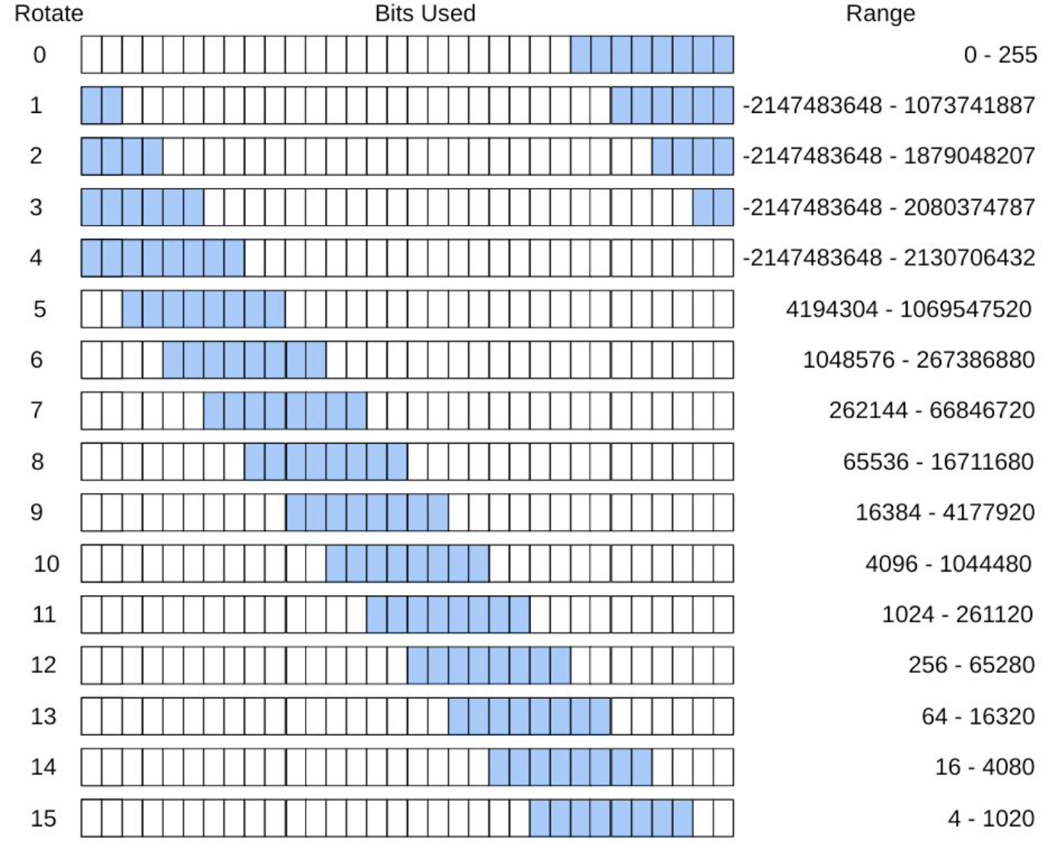
Rot4 - Imm8 Values
positions to
rotate X 2
unsigned value to rotate
How would 256 be encoded?
rotate = 12, imm8 = 1
Bottom line: the assembler will do this for you
If you try and use an immediate value that it cannot generate it will give an error
There is a workaround - later
00000001
results are interpreted as a 2's complement number
x

Slide 74
Branch Target Address (BTA): What Is imm24?
0001042c <inloop>:
1042c: e3530061 cmp r3, 0x61
10430: ba000002 blt 10440 <store>
10434: e353007a cmp r3, 0x7a
10438: ca000000 bgt 10440 <store>
1043c: e2433020 sub r3, r3, #32
00010440 <store>:
10440: e7c13002 strb r3, [r1, r2]
10444: e2822001 add r2, r2, 0x1
10448: e7d03002 ldrb r3, [r0, r2]
1044c: e3530000 cmp r3, 0x0
10450: 1afffff5 bne 1042c <inloop>
executing instruction
decode instruction
fetch instruction
Previous slide: phases of execution: (1) fetch, (2) decode, (3) execute
The pc (r15) contains the address of the instruction being fetched, which is two instructions ahead or executing instruction + 8 bytes
Branch target address (or imm24) is the distance measured in the # of instructions (signed, 2's complement) from the fetch address contained in r15 when executing the branch
BTA: + 2 instructions
target address = 0x10440
fetch address = 0x10438
distance(bytes) = 0x00008
distance(instructions)= 0x8/(4 bytes/instruction)= 0x2
imm24 | 0x 00 00 02
x

